Slide 1
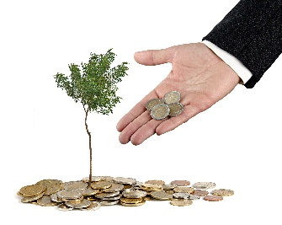

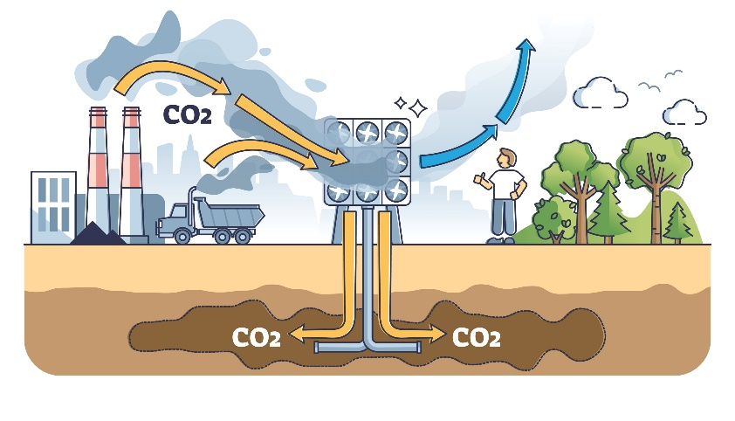



Offset your household’s footprint
SS1
You can reduce your carbon footprint but it’s impossible to reduce it to zero. So how do households and businesses become carbon neutral?
Offsetting options
1. Plant trees
Cost: £12.50 to offset 1 ton of CO₂
Each tree will remove CO₂ from the atmosphere. The trees can be planted near schools, to educate children and support habitats.
2: Reforestation
Cost: £10.00 to offset 1 ton of CO₂
Your funding supports the planting of trees in the Great Rift Valley in Kenya. The project employs local people.
By offsetting your carbon footprint. It means doing something to remove all the CO₂ your actions produce. Either you can do it, or you pay a company to do it for you.
What to do:
1. Recall your household’s carbon footprint (after actions), which you calculated earlier.
2. Look at the six options to offset your carbon footprint. Think about:
the economic consequences (how much they cost).
The social consequences (how they affect people).
The environmental consequences (how they affect habitats).
Choose a mix of at least two options.
3. Write your recommendations and present them to your household.:
3: Pay a carbon capture plant
Cost: £60 to offset 3 tons of CO₂
You will pay a carbon capture plant in Iceland to remove CO₂ from the air. The plant pumps the gas underground where it will slowly become stone.
4: Give households a cookstove
Cost: £30 to offset 2 tons of CO₂
Your money will give people in Malawi energy-efficient cookstoves to use instead of open fires. They use less firewood and emit less dangerous fumes.
We can offset ...tons of CO₂ at a cost of £...
The options I recommend are…
I chose these because…
Discuss this question together. Should every household offset their footprint. Why or why not?
5: Protect the rainforest
Cost: £100 to offset 4 tons of CO₂
Your funding will help to protect an area of rainforest in Brazil against deforestation, preserving this high biodiversity habitat.
6: Invest in a wind farm
Cost: £15.00 to offset 2 tons of CO₂
Your funding will help build a new wind farm in Panama. Wind power will provide communities with electricity without releasing any CO₂.
Student sheets

Slide 2

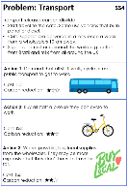
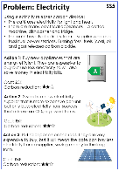
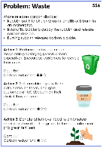
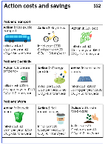
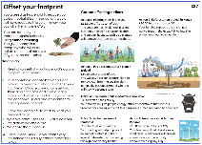
Help Coffee Club become carbon neutral
SS2
3. Write your recommendations
Here's what to include.
“We really care abut the planet and want to be carbon neutral, but we don’t want to spend too much money. So, we are hiring carbon consultants to recommend what to do.”
Introduction
What a carbon footprint is.
The café’s current carbon footprint.
What carbon neutral means.
Why it is important to be carbon neutral.
Middle
Actions
What actions you think the café should take.
The total initial and yearly costs.
Persuasive reasons to choose these actions (economic, social and environmental).
Offsetting
What carbon offsetting is.
What offsetting the café should use.
The yearly cost.
Persuasive reasons to choose this offsetting (economic, social and environmental).
Conclusion
Why this is the best plan for the café.
Why the owner should hire your team.
Rose – the café owner
You are a team of ‘carbon consultants’. You want to be chosen by the café to reduce their carbon footprint from 15 tons to 0. To do this, you will make your recommendations and present them to the owner.
Here is what to do: Resources to use:
1. How to reduce the footprint
There are three problems: transport, electricity and waste. Each has three possible actions.
Discuss the choices and choose one action for each problem.
Calculate total initial cost and yearly cost.
Add up how much CO₂ the actions will save.
Do your choices reduce the café’s carbon footprint to 0? If not, you need to change your choices.
SS4-6 from the ‘Choose actions’ activity
SS2: Action costs and savings
2. How to offset the footprint
Choose which carbon offsetting to use to get to carbon neutral.
Calculate the cost per year.
SS1: Offset your footprint

Slide 3
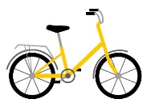









Action costs and savings
SS3
Action costs and savings
SS3
Problem: Transport
Problem: Transport
Action 1: Use public transport
Initial cost: £0
Cost per year: £0
CO₂: -0.6 tons/year
Action 2: Buy bikes
Initial cost: £500
Cost per year: £0
CO₂: -1.3 tons/year
Action 3: Buy local
Initial cost: £0
Cost per year: £600
CO₂: -1.1 tons/year
Action 1: Use public transport
Initial cost: £0
Cost per year: £0
CO₂: -0.6 tons/year
Action 2: Buy bikes
Initial cost: £500
Cost per year: £0
CO₂: -1.3 tons/year
Action 3: Buy local
Initial cost: £0
Cost per year: £600
CO₂: -1.1 tons/year
Problem: Electricity
Problem: Electricity
Action 1: Increase efficiency
Initial cost: £3000
Saving per year: £120
CO₂: -1.0 tons/year
Action 2: Change provider
Initial cost: £500
Cost per year: £180
CO₂: -1.4 tons/year
Action 3: Install solar
panels
Initial cost: £5000
Saving per year: £800
CO₂: -1.6 tons/year
Action 1: Increase efficiency
Initial cost: £3000
Saving per year: £120
CO₂: -1.0 tons/year
Action 2: Change provider
Initial cost: £500
Cost per year: £180
CO₂: -1.4 tons/year
Action 3: Install solar
panels
Initial cost: £5000
Saving per year: £800
CO₂: -1.6 tons/year
Problem: Waste
Problem: Waste
Action 1: Recycle more
Initial cost: £0
Cost per year: £720
CO₂: -0.8 tons/year
Action 2: Sell reusable cups
Initial cost: £0
Cost per year: £90
CO₂: -0.4 tons/year
Action 3: Donate food waste
Initial cost: £0
Cost per year: £0
CO₂: -0.2 tons/year
Action 1: Recycle more
Initial cost: £0
Cost per year: £720
CO₂: -0.8 tons/year
Action 2: Sell reusable cups
Initial cost: £0
Cost per year: £90
CO₂: -0.4 tons/year
Action 3: Donate food waste
Initial cost: £0
Cost per year: £0
CO₂: -0.2 tons/year
COFFEE
CLUB
COFFEE
CLUB

Slide 4
Assessment checklist
SS4
Award each ‘content’ item a mark out of 3, where 3 means it was fully covered.
Persuasive arguments should include a number of different economic, environmental and social consequences.
Section | Content | Group 1 | Group 2 | Group 3 | Group 4 | Group 5 | Group 6
Introduction | Carbon footprint explained
 | Carbon neutral explained
 | Explanation about why being carbon neutral is important
Actions | Three actions presented with costs
 | Achieves carbon neutral
 | Persuasive arguments about why to choose them
Offsetting | Offsetting explained
 | Recommendations given with cost per year
 | Persuasive arguments about why to choose them
Conclusion | Persuasive plea to choose their plan
Total for presentation
(mark out of 30)

